Slide 1
Quality improvement
OSAP Recipient meeting
August 20, 2019

Slide 2
Context
Definition
Key terms
Framework
Next steps
Topics
Quality improvement presentation

Slide 3
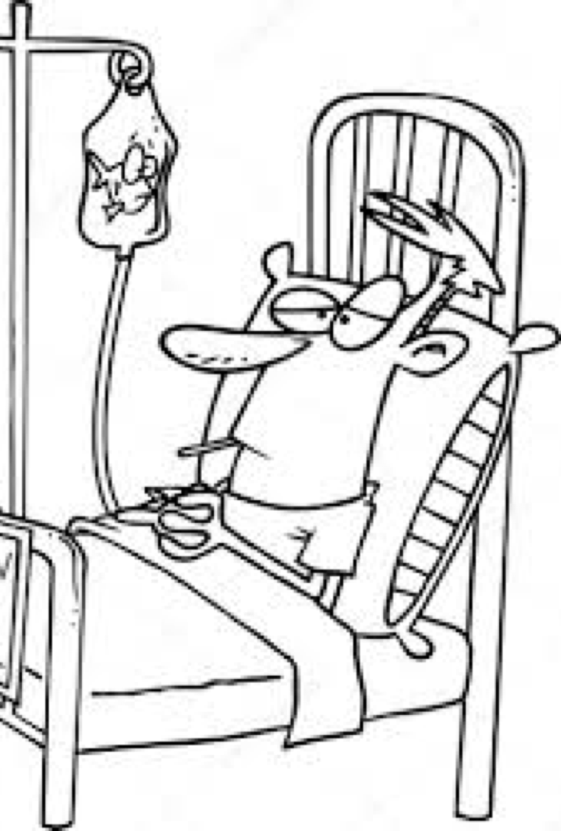
CONTEXT
MANUFACTURING
AUTOMOTIVE INDUSTRY
HEALTHCARE

Slide 4
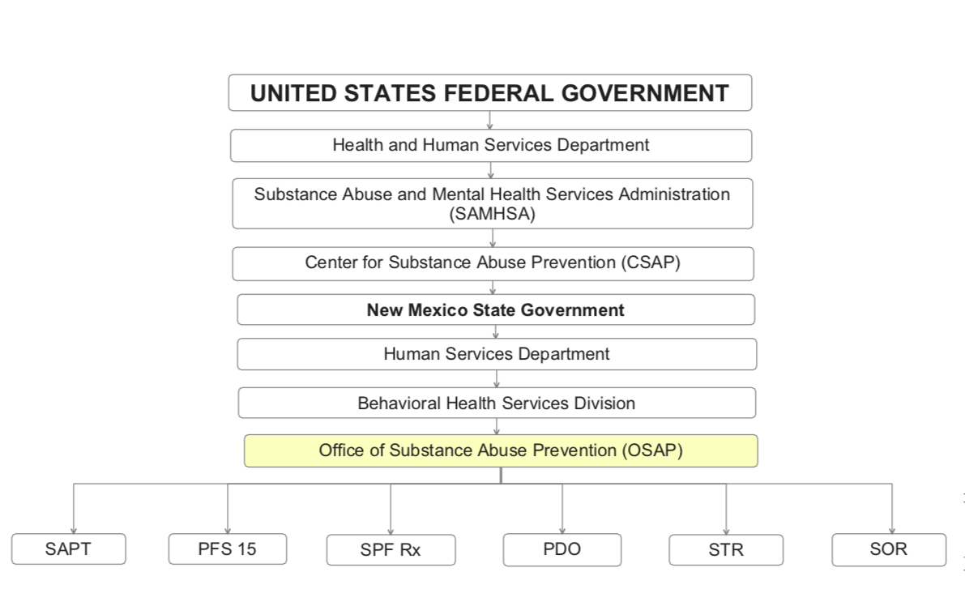
CONTEXT
Treatment services
are here, too

Slide 5
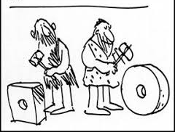
DEFINITION
Quality Improvement is systematic and continuous actions that lead to measurable improvement

Slide 6
Key terms
FIDELITY
DOSAGE
FREQUENCY
SCALE

Slide 7
fidelity
…What is the most impactful part of the strategy? - Or - What is the strategy really asking us to accomplish?
…Are each of the core components of the strategy clearly understood and being implemented?
…Are each of the core components well-timed and well-sequenced?
…Who does the strategy ask us to engage?
KEY TERMS - FIDELITY

Slide 8
frequency
How often …
…Are we engaging with stakeholders?
…Distributing messaging (enough to stand out but not too much to be drowned out)?
…Engaging high-risk populations and target populations?
…Reaching those whom we mean to reach?
KEY TERMS - FREQUENCY

Slide 9
DOSAGE
…How well-known in our community are our efforts?
…Are all strategies being implemented consistently, strongly and widely?
…Are our messages and strategies strong enough to change behavior?
…Is our audience exposed often enough to our message that it might change behavior?
KEY TERMS - DOSAGE

Slide 10
SCALE
…How far is our reach?
…Is our target population being impacted by our efforts?
…Does our strategy reach enough of our target population to change a community level measure?
…Do we have enough partners at the table and engaged in our efforts?
KEY TERMS - SCALE

Slide 11
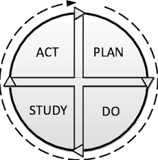
FRAMEWORK

Slide 12
FRAMEWORK – PLAN DO STUDY ACT
WHAT ARE WE TRYING TO ACCOMPLISH?
HOW WILL WE KNOW THAT A CHANGE IS AN IMPROVEMENT?
WHAT CHANGES CAN WE MAKE THAT WILL RESULT IN AN IMPROVEMENT?
Source: National Access and Retention Network for Addiction Treatment

Slide 13
PLAN
Identify an objective
Ask questions and make predictions (why)
Plan to carry out the cycle (who, what, where, when)
Source: National Access and Retention Network for Addiction Treatment

Slide 14
do
Carry out the plan
Document observations, accomplishments and barriers
Begin analyzing the data
Source: National Access and Retention Network for Addiction Treatment

Slide 15
study
Complete the analysis of the data
Compare data to predictions
Summarize what was learned
Source: National Access and Retention Network for Addiction Treatment

Slide 16
act
What changes will be made to the next cycle in order to be more successful?
What will we abandon/adapt/adopt?
Source: National Access and Retention Network for Addiction Treatment

Slide 17
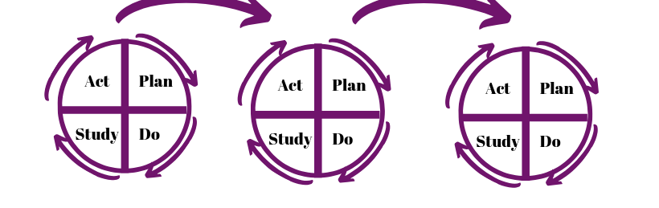
REPEAT CYCLE

Slide 18
 | Plan |  |  | Do | Study |  | Act
PDSA Cycle # | What change will you test? | What questions are you trying to answer? | What do you predict will happen (1 per question)? Predict Time & Accuracy Score | What did you discover while testing? What did you note that was expected/unexpected? | Go back to your measures and questions in your plan. What are the results of your test for each? | What did you learn in this test cycle? | Adapt (how?), Adopt, Abandon? | Was anything uncovered that could be an alternative change to test?
TRACKING PLAN DO STUDY ACT

Slide 19
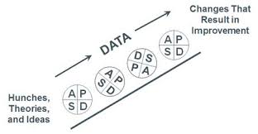

Slide 20
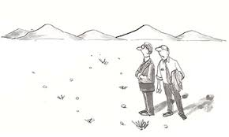
Where do we go from here?

Slide 21
Qi WORKSHOP(S) learning objectives
NEXT STEPS
To be able to:
Understand quality improvement basics
Explain Plan Do Study Act to coalition members
Apply Plan Do Study Act to prevention work
Create a Plan Do Study Act plan for one evidenced-based environmental prevention strategy
QI WORKSHOPS

Slide 22
Stay tuned for more training details and information to come

Slide 23
Thank you!
For questions, comments and/or feedback please contact
Andrea Niehaus
andreaniehaus.nm@gmail.com

